Slide 1
Amortized Analysis: Accounting Method
Idea:
  Assign differing charges to different operations.
  The amount of the charge is called amortized cost.
  amortized cost is more or less than actual cost.
  When amortized cost > actual cost, the difference is saved in specific objects as credits.
  The credits can be used by later operations whose amortized cost < actual cost.
As a comparison, in aggregate analysis, all operations have same amortized costs.

Slide 2
Accounting Method (cont.)
Conditions:
  suppose actual cost is c_{i} for the ith operation in the sequence, and amortized cost is c_{i}',
  ∑_{i=1}^{n} c_{i}' ≥∑_{i=1}^{n} c_{i} should hold.
    since we want to show the average cost per operation is small using amortized cost, we need the total amortized cost is an upper bound of total actual cost.
    holds for all sequences of operations.
  Total credits is ∑_{i=1}^{n} c_{i}' - ∑_{i=1}^{n} c_{i} , which should be nonnegative,
    Moreover, ∑_{i=1}^{t} c_{i}' - ∑_{i=1}^{t} c_{i} ≥0 for any t>0.

Slide 3
Accounting Method: Stack Operations
Actual costs:
  PUSH :1, POP :1, MULTIPOP: min(s,k).
Let assign the following amortized costs:
  PUSH:2, POP: 0, MULTIPOP: 0.
Similar to a stack of plates in a cafeteria.
  Suppose $1 represents a unit cost.
  When pushing a plate, use one dollar to pay the actual cost of the push and leave one dollar on the plate as credit.
  Whenever POPing a plate, the one dollar on the plate is used to pay the actual cost of the POP. (same for MULTIPOP).
  By charging PUSH a little more, do not charge POP or MULTIPOP.
The total amortized cost for n PUSH, POP, MULTIPOP is O(n), thus O(1) for average amortized cost for each operation.
Conditions hold: total amortized cost ≥total actual cost, and amount of credits never becomes negative.

Slide 4
Accounting method: binary counter
Let $1 represent each unit of cost (i.e., the flip of one bit).
Charge an amortized cost of $2 to set a bit to 1.
Whenever a bit is set, use $1 to pay the actual cost, and store another $1 on the bit as credit.
When a bit is reset, the stored $1 pays the cost.
At any point, a 1 in the counter stores $1, the number of 1’s is never negative, so is the total credits.
At most one bit is set in each operation, so the amortized cost of an operation is at most $2.
Thus, total amortized cost of n operations is O(n), and average is O(1).

Slide 5
The Potential Method
Same as accounting method: something prepaid is used later.
Different from accounting method
  The prepaid work not as credit, but as “potential energy”, or “potential”.
  The potential is associated with the data structure as a whole rather than with specific objects within the data structure.

Slide 6
The Potential Method (cont.)
Initial data structure D₀,
n operations, resulting in D₀, D₁,…, D_{n} with costs c₁, c₂,…, c_{n}.
A potential function Φ: {D_{i}} → R (real numbers)
Φ(D_{i}) is called the potential of D_{i}.
Amortized cost c_{i}' of the ith operation is:
  c_{i}' = c_{i} + Φ(D_{i}) - Φ(D_{i-1}). (actual cost + potential change)
∑_{i=1}^{n} c_{i}' = ∑_{i=1}^{n} (c_{i} + Φ(D_{i}) - Φ(D_{i-1}))
= ∑_{i=1}^{n}c_{i} + Φ(D_{n}) - Φ(D₀)

Slide 7
The Potential Method (cont.)
If Φ(D_{n}) ≥ Φ(D₀), then total amortized cost is an upper bound of total actual cost.
But we do not know how many operations, so Φ(D_{i}) ≥ Φ(D₀) is required for any i.
It is convenient to define Φ(D₀)=0,and so Φ(D_{i}) ≥0, for all i.
If the potential change is positive (i.e., Φ(D_{i}) - Φ(D_{i-1})>0), then c_{i}' is an overcharge (so store the increase as potential),
otherwise, undercharge (discharge the potential to pay the actual cost).

Slide 8
Potential method: stack operation
Potential for a stack is the number of objects in the stack.
So Φ(D₀)=0, and Φ(D_{i}) ≥0
Amortized cost of stack operations:
  PUSH:
    Potential change: Φ(D_{i})- Φ(D_{i-1}) =(s+1)-s =1.
    Amortized cost: c_{i}' = c_{i} + Φ(D_{i}) - Φ(D_{i-1})=1+1=2.
  POP:
    Potential change: Φ(D_{i})- Φ(D_{i-1}) =(s-1) –s= -1.
    Amortized cost: c_{i}' = c_{i} + Φ(D_{i}) - Φ(D_{i-1})=1+(-1)=0.
  MULTIPOP(S,k): k'=min(s,k)
    Potential change: Φ(D_{i})- Φ(D_{i-1}) = –k'.
    Amortized cost: c_{i}' = c_{i} + Φ(D_{i}) - Φ(D_{i-1})=k'+(-k')=0.
So amortized cost of each operation is O(1), and total amortized cost of n operations is O(n).
Since total amortized cost is an upper bound of actual cost, the worse case cost of n operations is O(n).

Slide 9
Potential method: binary counter
Define the potential of the counter after the ith INCREMENT is Φ(D_{i}) =b_{i}, the number of 1’s. clearly, Φ(D_{i})≥0.
Let us compute amortized cost of an operation
  Suppose the ith operation resets t_{i} bits.
  Actual cost c_{i} of the operation is at most t_{i} +1.
  If b_{i}=0, then the ith operation resets all k bits, so b_{i-1}=t_{i}=k.
  If b_{i}>0, then b_{i}=b_{i-1}-t_{i}+1
  In either case, b_{i}≤b_{i-1}-t_{i}+1.
  So potential change is Φ(D_{i}) - Φ(D_{i-1}) ≤b_{i-1}-t_{i}+1-b_{i-1}=1-t_{i.}
  So amortized cost is: c_{i}' = c_{i} + Φ(D_{i}) - Φ(D_{i-1}) ≤ t_{i} +1+1-t_{i}=2.
The total amortized cost of n operations is O(n).
Thus worst case cost is O(n).

Slide 10
Amortized analyses: dynamic table
A nice use of amortized analysis
Table-insertion, table-deletion.
Scenario:
  A table –maybe a hash table
  Do not know how large in advance
  May expend with insertion
  May contract with deletion
  Detailed implementation is not important
Goal:
  O(1) amortized cost.
  Unused space always ≤ constant fraction of allocated space.

Slide 11
Dynamic table
Load factor α = num/size, where num = # items stored, size = allocated size.
If size = 0, then num = 0. Call α = 1.
Never allow α > 1.
Keep α >a constant fraction → goal (2).

Slide 12
Dynamic table: expansion with insertion
Table expansion
Consider only insertion.
When the table becomes full, double its size and reinsert all existing items.
Guarantees that α ≥ 1/2.
Each time we actually insert an item into the table, it’s an elementary insertion.

Slide 13
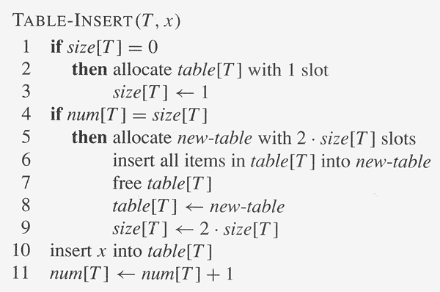
Copyright © The McGraw-Hill Companies, Inc. Permission required for reproduction or display.
Num[t] ele. insertion
1 ele. insertion
Initially, num[T ] = size[T ] = 0.

Slide 14
Aggregate analysis
Running time: Charge 1 per elementary insertion. Count only elementary insertions,
since all other costs together are constant per call.
ci = actual cost of ith operation
  If not full, ci = 1.
  If full, have i − 1 items in the table at the start of the ith operation. Have to copy all i − 1 existing items, then insert ith item, ⇒ ci = i
Cursory analysis: n operations ⇒ ci = O(n) ⇒ O(n²) time for n operations.
Of course, we don’t always expand:
  ci = i if i − 1 is exact power of 2 ,
  1 otherwise .
So total cost =∑_{i=1}^{n} ci ≤n+ ∑_{i=0}^{log(n)} 2^{i} ≤n+2n=3n
Therefore, aggregate analysis says amortized cost per operation = 3.

Slide 15
Accounting analysis
Charge $3 per insertion of x.
  $1 pays for x’s insertion.
  $1 pays for x to be moved in the future.
  $1 pays for some other item to be moved.
Suppose we’ve just expanded, size = m before next expansion, size = 2m after next expansion.
Assume that the expansion used up all the credit, so that there’s no credit stored after the expansion.
Will expand again after another m insertions.
Each insertion will put $1 on one of the m items that were in the table just after expansion and will put $1 on the item inserted.
Have $2m of credit by next expansion, when there are 2m items to move. Just enough to pay for the expansion, with no credit left over!

Slide 16
Potential method
Potential method
Φ(T ) = 2 ・ num[T ] − size[T ]
Initially, num = size = 0⇒ Φ = 0.
• Just after expansion, size = 2 ・ num ⇒ Φ = 0.
Just before expansion, size = num ⇒ Φ = num ⇒ have enough potential to pay for moving all items.
Need Φ ≥ 0, always.
Always have
  size ≥ num ≥ ½ size ⇒ 2 ・ num ≥ size ⇒ Φ ≥ 0 .

Slide 17
Potential method
Amortized cost of ith operation:
  num_{i} = num after ith operation ,
  size_{i} = size after ith operation ,
  Φ_{i} = Φ after ith operation .
If no expansion:
  size_{i} = size_{i−1} ,
  num_{i} = num_{i−1} +1 ,
  ci = 1 .
Then we have
  C_{i}’ = c_{i} + Φ_{i} − Φ_{i−1} = 1 + (2num_{i} −size_{i} ) − (2num_{i−1} −size_{i−1}) =3.
If expansion:
  size_{i} = 2size_{i−1} ,
  size_{i−1} = num_{i−1} = num_{i} −1 ,
  c_{i} = num_{i−1} +1 = num_{i}.
Then we have
C_{i}’ = c_{i} + Φ_{i} − Φ_{i−1} = num_{i} + (2num_{i} −size_{i} ) − (2num_{i−1} −size_{i−1}) = num_{i} + (2num_{i} −2(num_{i} −1)) − (2(num_{i} −1) − (num_{i} −1)) = num_{i} + 2 − (num_{i} −1) = 3

Slide 18
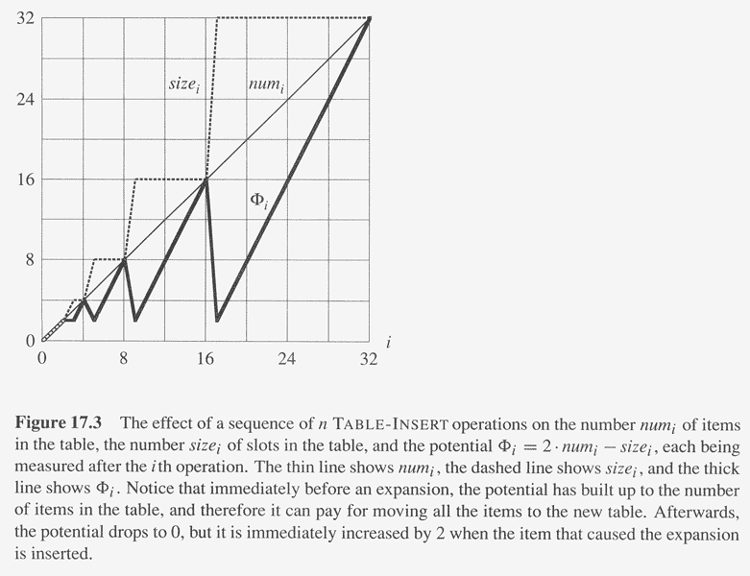
Copyright © The McGraw-Hill Companies, Inc. Permission required for reproduction or display.

Slide 19
Expansion and contraction
Expansion and contraction
When α drops too low, contract the table.
  Allocate a new, smaller one.
  Copy all items.
Still want
  α bounded from below by a constant,
  amortized cost per operation = O(1).
Measure cost in terms of elementary insertions and deletions.

Slide 20
Obvious strategy
Double size when inserting into a full table (when α = 1, so that after insertion α would become <1).
Halve size when deletion would make table less than half full (when α = 1/2, so that after deletion α would become >= 1/2).
Then always have 1/2 ≤ α ≤ 1.
Suppose we fill table.
  Then insert ⇒ double
  2 deletes ⇒ halve
  2 inserts ⇒ double
  2 deletes ⇒ halve
  ・ ・ ・
  Cost of each expansion or contraction is Θ(n), so total n operation will be Θ(n²).
Problem is that: Not performing enough operations after expansion or contraction to pay for the next one.

Slide 21
Simple solution
Double as before: when inserting with α = 1 ⇒ after doubling, α = 1/2.
Halve size when deleting with α = 1/4 ⇒ after halving, α = 1/2.
Thus, immediately after either expansion or contraction, have α = 1/2.
Always have 1/4 ≤ α ≤ 1.
Intuition:
Want to make sure that we perform enough operations between consecutive expansions/contractions to pay for the change in table size.
Need to delete half the items before contraction.
Need to double number of items before expansion.
Either way, number of operations between expansions/contractions is at least a constant fraction of number of items copied.

Slide 22
Potential function
Φ(T) = 2num[T] − size[T] if α ≥ ½
size[T]/2 −num[T] ifα < ½ .
T empty ⇒ Φ = 0.
α ≥ 1/2 ⇒ num ≥ 1/2size ⇒ 2num ≥ size ⇒ Φ ≥ 0.
α < 1/2 ⇒ num < 1/2size ⇒ Φ ≥ 0.

Slide 23
intuition
measures how far from α = 1/2 we are.
  α = 1/2 ⇒ Φ = 2num−2num = 0.
  α = 1 ⇒ Φ = 2num−num = num.
  α = 1/4 ⇒ Φ = size /2 − num = 4num /2 − num = num.
Therefore, when we double or halve, have enough potential to pay for moving all num items.
Potential increases linearly between α = 1/2 and α = 1, and it also increases linearly between α = 1/2 and α = 1/4.
Since α has different distances to go to get to 1 or 1/4, starting from 1/2, rate of increase differs.
For α to go from 1/2 to 1, num increases from size /2 to size, for a total increase of size /2. Φ increases from 0 to size. Thus, Φ needs to increase by 2 for each item inserted. That’s why there’s a coefficient of 2 on the num[T ] term in the formula for when α ≥ 1/2.
For α to go from 1/2 to 1/4, num decreases from size /2 to size /4, for a total decrease of size /4. Φ increases from 0 to size /4. Thus, Φ needs to increase by 1 for each item deleted. That’s why there’s a coefficient of −1 on the num[T ] term in the formula for when α < 1/2.

Slide 24
Amortized cost for each operation
Amortized costs: more cases
  insert, delete
  α ≥ 1/2, α < 1/2 (use α_{i}, since α can vary a lot)
  size does/doesn’t change

Slide 25
Splay tree
A binary search tree (not balanced)
Height may be larger than log n, even n-1.
However a sequence of n operations takes O(nlog n).
Assumptions: data values are distinct and form a totally order set
Operations:
  Member(i,S)
  Insert(i,S)
  Delete(i,S)
  Merge(S,S’)
  Split(i,S)
  All based on
    splay(i,S), reorganize tree so that i to be root if i∈S, otherwise, the new root is either max{k ∈S |k<i} or min{k ∈S |k>i}

Slide 26
Splay tree (cont.)
For examples,
  merge(S,S’)
    Call Splay(∞, S) and then make S’ the right child
  Delete(i,S), call Splay(i,S), remove I, then merge(left(i), right(i)).
  Similar for others.
  Constant number of splays called.

Slide 27
Splay tree (cont.)
Splay operation is based on basic rotate(x) operation (either left or right).
Three cases:
  y is the parent of x and x has not grandparent
    rotate(x)
  x is the left (or right) child of y and y is the left (or right) child of z,
    rotate(y) and then rotate(x)\
  x is the left (or right) child of y and y is the right (or left) child of z,
    rotate(x) and then rotate(x)

Slide 28
Splay tree (cont.)
Credit invariant: Node x always has at least log μ(x) credits on deposit.
  Where μ(S)=log (|S|) and μ(x)=μ(S(x))
Lemma:
  Each operation splay(x,S) requires no more than 3(μ(S)-μ(x))+1 credits to perform the operation and maintain the credit invariant.
Theorem:
  A sequence of m operations involving n inserts takes time O(mlog(n)).

Slide 29
Summary
Amortized analysis
  Different from probabilistic analysis
Three methods and their differences
how to analyze

